Slide 1
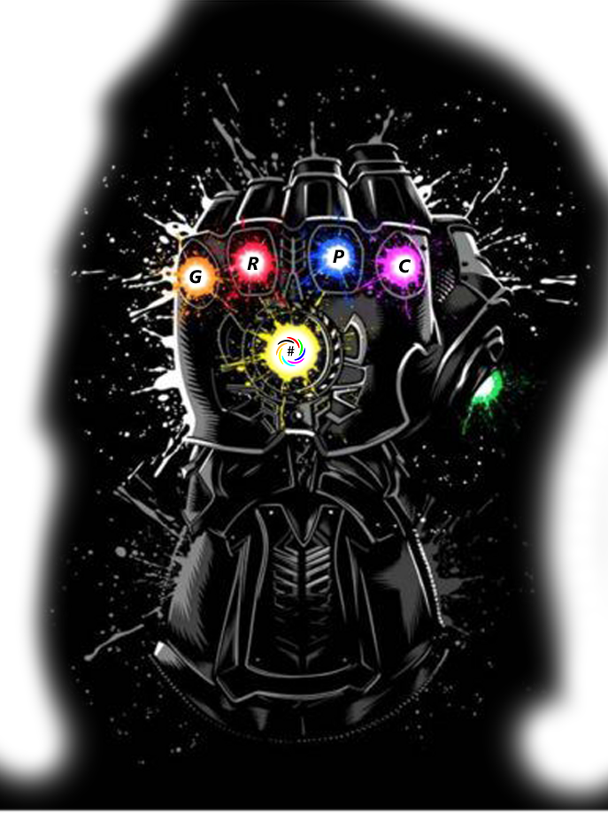
#PitchOnline presents:

Slide 2
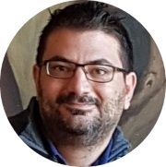
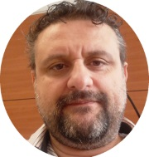
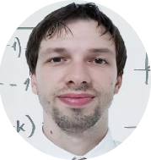
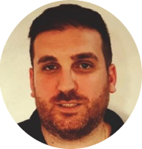
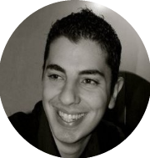
GRPC In Your Hand
Scifoni Ivano
Fabio Mannis
Francesco Del Re
Matteo Riccardi
Valerio Benedetti

Slide 3
GRPC In Your Hand
Agenda

Slide 4
GRPC In Your Hand

Slide 5
Questions
&
Answers

Slide 6
GRPC In Your Hand

Slide 7
Thank You!
Our Socials

